Slide 1


ArcGIS API for JavaScript: Using Arcade with your Apps
Damien Robinson and Rene Rubalcava
Notes:
[RENE]
Welcome
Personal Introduction
[DAMIEN]
Personal Introduction
[NEXT SLIDE]

Slide 2


Thank You to Our Generous Sponsor
Notes:
[DAMIEN]
Just a quick thanks to our sponsor con-terra for their continued generous support

Slide 3
Session Goals
Overview of Arcade
What is Arcade
Why use Arcade
Arcade Language
Variables, Functions, Loops, Conditional Statements
Arcade and the ESRI JavaScript API
Using Arcade in Custom Apps
Notes:
[DAMIEN]
In this session, we are going to give an Overview of Arcade… What it is, and why you would want to use it.
We are going to look at the language, and then lastly look at how you can use it in your own Apps, written in JavaScript.
Now Lets get into the really important questions. There are some common questions we are most commonly asked about Arcade
- What is Arcade?
- Why is it called Arcade?
- Why do I need another language?
- What can I do with Arcade?
[NEXT SLIDE]

Slide 4
A new expression language for the ArcGIS Platform
ArcGIS Pro
Runtime SDKs
JavaScript API
Web apps
Primarily designed for ArcGIS web maps and web scenes
What is Arcade?
Notes:
[DAMIEN]
First question is normally, what is Arcade?
It is an expression language for the whole platform
By expression language we mean expressions that can be embedded in the webmap or scene. These expressions will add extra logic on how the map should be rendered, labelling, symbology etc. We want the expressions to be portable and shareable across the ArcGIS platform and to add a little je ne sais quoi to your apps.
[NEXT SLIDE]

Slide 5
Arcade Purpose
Arcade is NOT intended to be a Full Programming / Scripting Language
Goal : Lightweight and Simple
Equivalent to a Spreadsheet Cell Calculation
Embedded Expressions
Labeling, Rendering, Symbol Variation, ….
Sharing
Not a replacement for Python for geoprocessing and Automation
Input Values
Arcade
Expression
Result Value
Notes:
[DAMIEN]
This is why we have developed Arcade… It is not designed as a Full Programming or Scripting Language, but as a Simple Expression Language.
Think of it as similar to an Excel Spreadsheet cell calculation.
It is simply intended to take input values, evaluate them, and return a result value. It is not a replacement for any of the existing ArcGIS API’s/SDK’s, it complements these rather than competing with them.
[NEXT SLIDE]

Slide 6
Hello World
And a few more examples…
Notes:
[DAMIEN]
What better way to introduce a language with a simple hello world example.
Playground – Hello World
[EXIT TO PLAYGROUND DEMO]
Hello World
1 + 20 + 30
var person = “Damien”
“Hello” + person
function greet(person){
return “Hello” + person}
greet(“Berlin!”)

Slide 7


Why is it called Arcade?
Notes:
[DAMIEN]
So why is it called Arcade, sorry to disappoint but it is not an ode to pacman, space invaders or rigged teddy grabbing machines, rather it refers to the anglicized covered shopping street common in the UK, as opposed to amusement arcades.
To further delve into the etymology of our naming, Esri have a long history of calling Languages After Types of Street, for example Avenue. The UK Connection is maintained as the principle Development Team was in Cardiff, Wales. We did not want to call it Roundabout, as we thought it might set the wrong impression, but considered other options like boulevard.
So an Arcade, using the anglicized version of the word, infers a small, self-contained, sheltered Shopping Street. This is Seemed to Work with the whole self-contained lightweight theme of the language, Plus it has the added bonus of having the word Arc in the title!!!
[NEXT SLIDE]

Slide 8
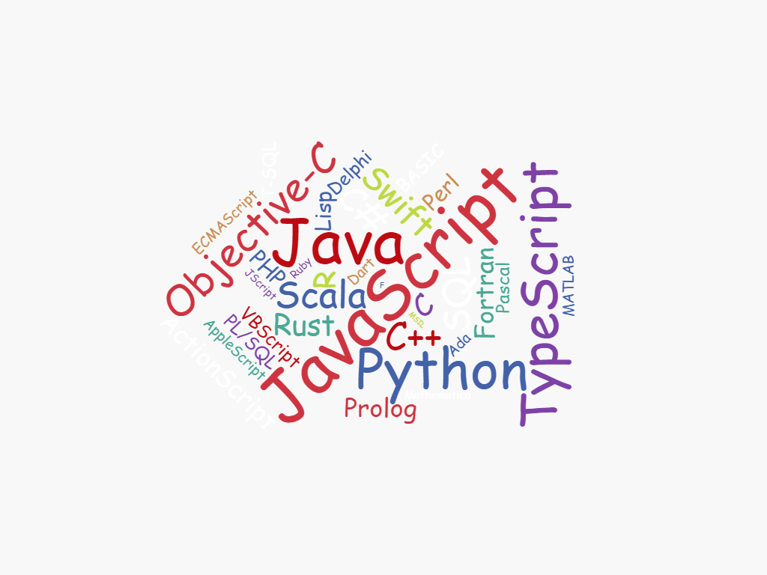
Why do I need another language?
Notes:
[DAMIEN]
The next question is one of the most common questions asked, Why do I need another language? There are so many to choose from..
We put a lot of thought into why we were writing Arcade, and the problem it solves… As we go through the talk… you will hopefully see why we have gone down this route, and see the gap it is trying to plug.
[NEXT SLIDE]

Slide 9
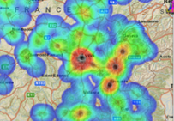
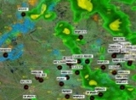
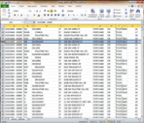
ArcGIS: Make, Share, Anywhere
Notes:
[DAMIEN]
In my opinion, Arcade fills the gap around sharing and publishing maps and analyses.
If we have customised maps with logic written in Python, or JavaScript, it becomes difficult to share the map, and use it across the ArcGIS Platform. We needed to provide a highly portable, lightweight, consistent expression language that can be utilised in all the places you want to have access to the map.
[NEXT SLIDE]

Slide 10


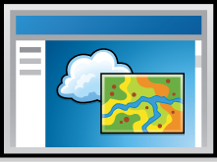
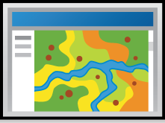
ArcGIS Environments and Platforms
Smart Phones
Social Media
Tablets
Web Sites
Desktop
Browsers
Notes:
[DAMIEN]
Another view is to look at all the different Environments that the ArcGIS Platform runs on
It runs on Desktop, Tablets, Phones, Embedded in Social Media, as WebSites
[NEXT SLIDE]

Slide 11



ArcGIS: Make, Share, Anywhere - Challenges
Traditional Development / Scripting Languages
Browser based Apps
Mobile and Native Apps
Size of Executable
Security
Native Access
Page Size
Security
XSS
No Binaries
Notes:
[DAMIEN]
There is often a question on why you cannot just share customised logic already.
For example, say you have written a labelling expression in Python in ArcGIS Pro… why can you just not include python on mobile devices, or the JavaScript engine..
The problem is twofold. Bundling Python or JavaScript is very sizeable, for resource constrained devices.
And Secondly, more importantly… Security.. Scripts written in JavaScript or Python can do anything… Which means you need to somehow run them in a sandbox, or similar. It would be very easy to run malicious code with a fully bundled version fo Python or JavaScript.
For Browser based applications… They only run JavaScript, so your python script will not work… Or you will have network latency to run a python on a server trying to process large numbers of features…
With regards to security, issues around executing random JavaScript are not going to be very acceptable to Sys Admins from the perspective of cross site scripting.
Arcade as a lightweight portable expression language enables cross platform consistency that you simply can’t get from existing scripting languages on the ArcGIS Platform.
[NEXT SLIDE]

Slide 12
Arcade Goals
Portable
Write an Expression in Pro, have it run in a Browser, or on a Device
Secure
Ensure that Expressions or Scripting do not compromise Security
Lightweight
Most requirements for Scripts and Expressions are Lightweight. The language should be small, and fast
Geospatial
Scripts should treat Geospatial as First Class Members
Notes:
[DAMIEN]
The goals of Arcade are as follows
Portability – being able to use the expression regardless of the environment
Security – avoiding introducing obvious security vulnerabilities
Lightweight – for performance and resources
Finally, and most importantly, at its core is Geospatiality. This is a scripting language for the ArcGIS Platform afterall! Geometry/features hence are treated as first class members.
[NEXT SLIDE]

Slide 13
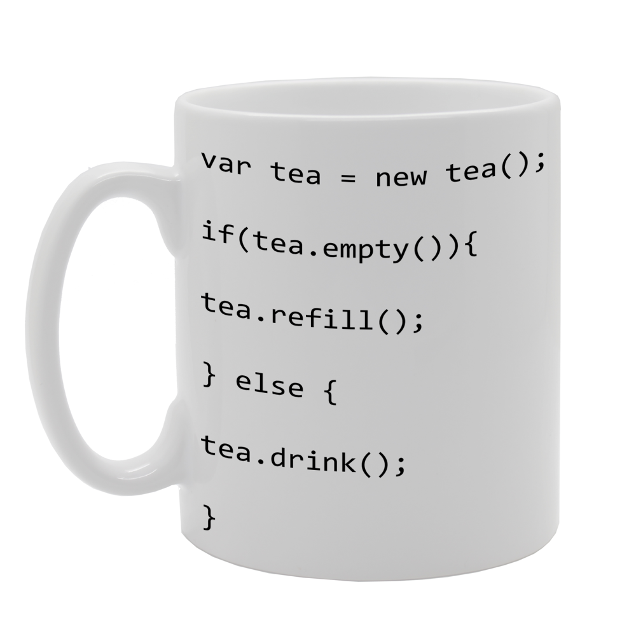
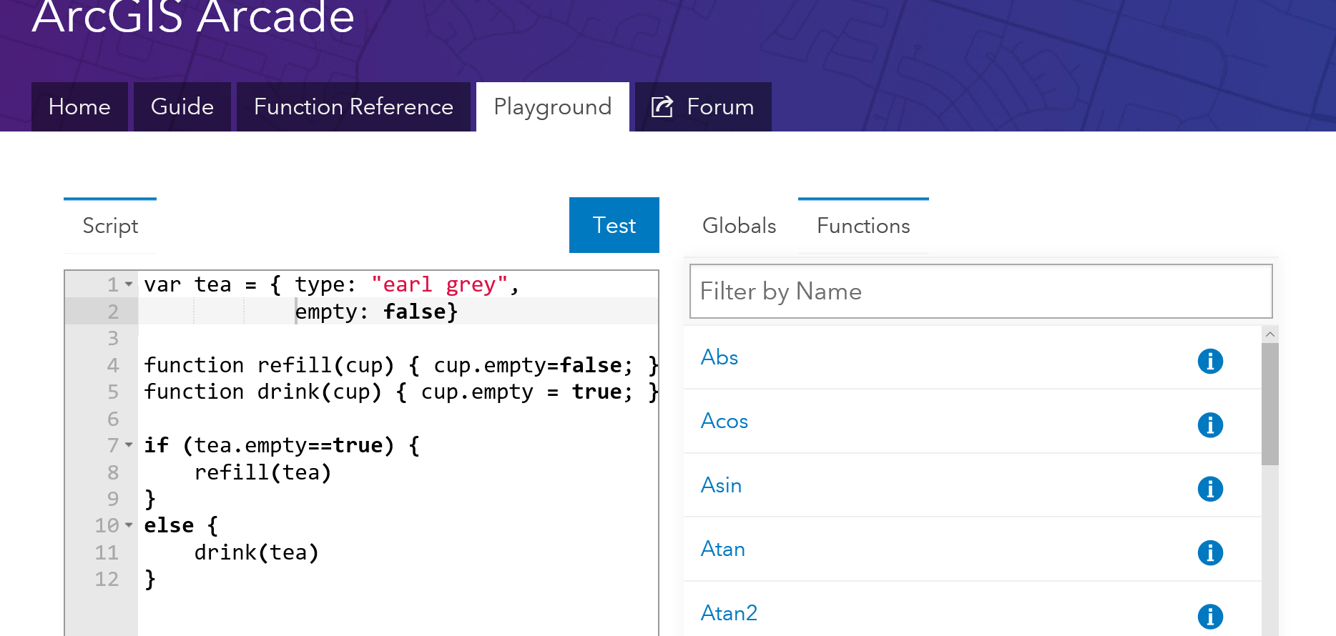
What can I do with it?
Notes:
[DAMIEN]
The final question we mentioned at the beginning of this session was, what can I do with Arcade?
Well there is what you can do now, versus what it is intended you can do in future. As Arcade is a new kid on the block, as it matures it will introduce more and more functionality and capability.
Similar to the hello world example, it is possible to take the classic tea problem, and write it in Arcade, as shown on screen!
The best way to explain what you can do with it, is to demo it! Myself and Rene will demo a number of potential uses throughout the remainder of the session.
[NEXT SLIDE]

Slide 14
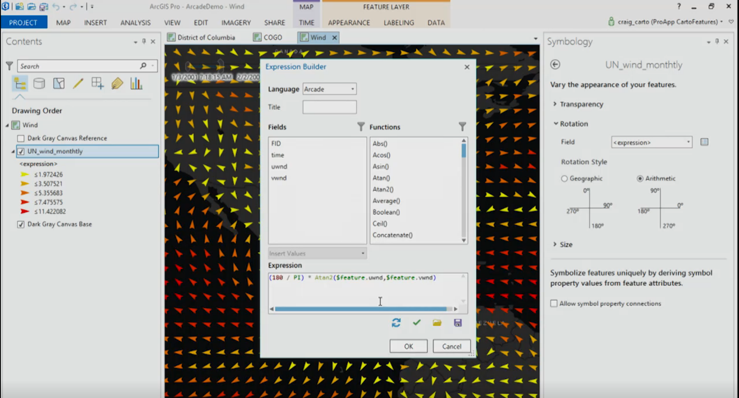
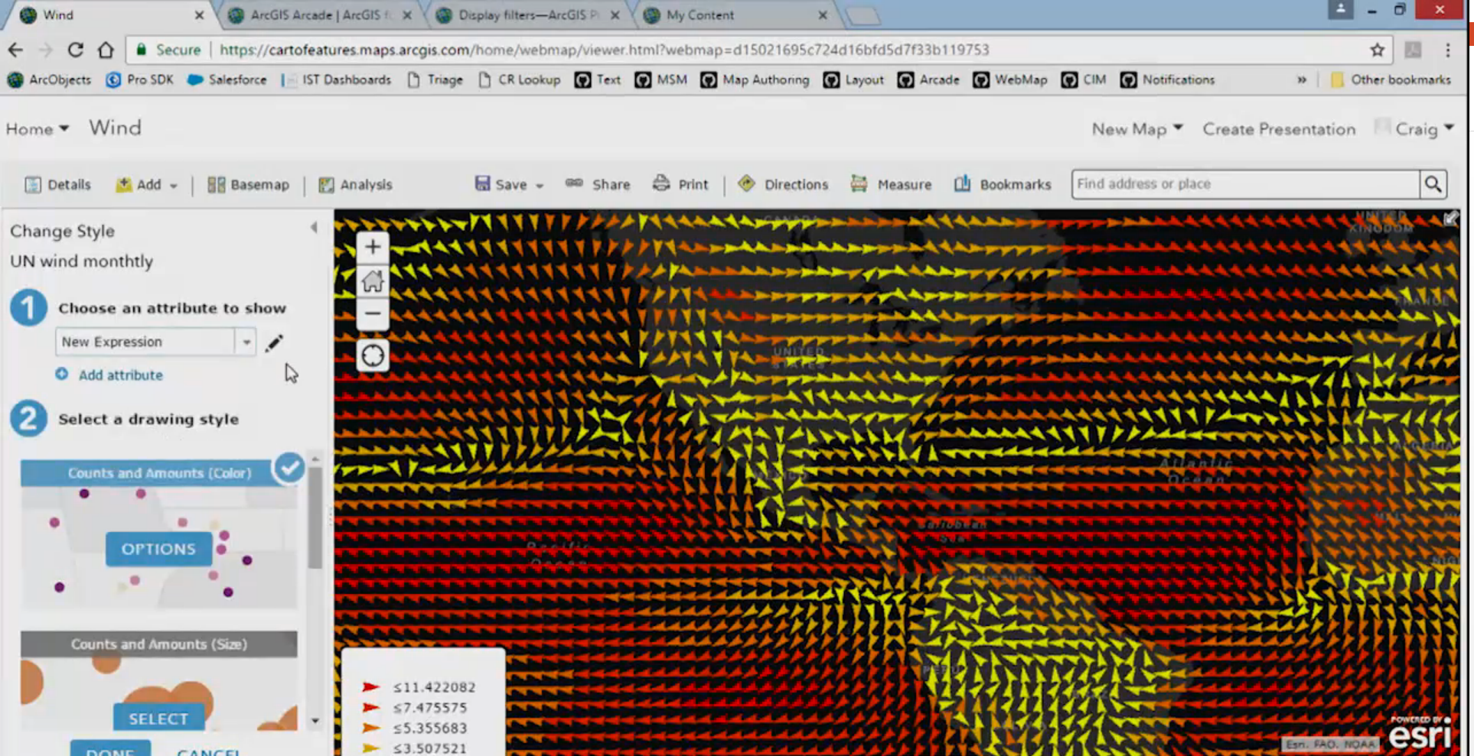
Arcade Examples
Notes:
[DAMIEN]
DEMO 1
DEMO 2
[NEXT SLIDE]

Slide 15
Language Overview
Type System
Flow Control
Statements
Functions
Statements
and Operators
Notes:
[DAMIEN]
OK… Hopefully you can now see why Arcade fills a much needed gap and why we are so excited about its potential.
We are now going to go into the nuts and bolts of Arcade. So you can see how we have tried to reach the goals of simplicity and ease of use, but also so you can see how to achieve common tasks.
[NEXT SLIDE]

Slide 16
Arcade : Language Features
Designed for Simple Expressions
Single Line - Implicit Returns
Case Insensitive Language
Dictionary Syntax for Field Access
Has Language Features to Support more Complex Scripts
Type System
Implicit and Explicit Type Casting
Flow Control Statements: IF, FOR
Variable Declaration and Assignments
User Defined Functions
Arcade Scripts run and return a value. They are self contained and cannot alter their environment.
Notes:
[DAMIEN]
Firstly , we tried to design the language for Simple Expressions, and Familiarity..
We wanted it to work for the simplest of single line expressions…. Say just to put a calculation in based on a Field.
We also recognised that many of the labelling, rendering scripts that exists in Pro today, written in Python can be quite complex…
So we wanted to support more complex language features.
Do need to emphasize though, that Arcade is not intended to change its environment, it is simply a calculator, and is self contained.
[NEXT SLIDE]

Slide 17
Implicit Returns
(10 + 100) * 30
Equivalent to:
return (10 + 100) * 30;
Implicit Returns
Last executable statement that is a value, will automatically be considered the return value.
Enables very simple Single Line Expressions
Notes:
[DAMIEN]
So firstly for simple expressions, we have the concept of implicit Returns.
The last executable statement that is a value, will automatically be considered the return value… Allows you, for single line expressions, not to have to use the return statement.
A small feature, but allows very succinct single line expressions.
[NEXT SLIDE]

Slide 18
Case Insensitive
UpPeR(“Hello”)
$FeAtUrE.FiElD1
Language is Case Insensitive
Quicker to Author
Simpler for working with Data, and Field Names
Notes:
[DAMIEN]
We had a lot of discussions on case insensitivity.
We have made the language case insensitive so it is less fussy to author. However the main reason, was to make it easier to work with data and fields. You can see that it not only takes effect for functions but also for access variables, properties of the feature, dictionary entries.
[NEXT SLIDE]

Slide 19
Functions
Data Functions
Dictionary
DomainCode
DomainName
Feature
First
HasKey
IndexOf
Reverse
Sort
TypeOf
Date Functions
Date
DateAdd
DateDiff
Millisecond
Second
Minute
Hour
Month
Weekday
Year
Day
Now
Today
Timestamp
ToLocal
ToUTC
Geometry Functions
Geometry
Multipoint
Extent
Point
Polyline
Polygon
Logical Functions
IsEmpty
DefaultValue
When
Decode
Iif
Boolean
Mathematical Functions
Abs
Acos
Asin
Atan
Atan2
Average
Ceil
Cos
Count
Exp
Floor
Log
Min
Max
Number
Pow
Random
Round
Text Functions
Concatenate
Console
Find
Lower
Left
Mid
Proper
Replace
Right
Split
Text
Trim
Upper
Sin
Sqrt
Stdev
Sum
Tan
Variance
“
Functions are the Power of Arcade
Notes:
[DAMIEN]
The key to the language though is the range of functions, and we want to add a lot more!
[NEXT SLIDE]

Slide 20

Global Variables and Profiles
Labeling
Visualization
Use Expressions to provide values required for different types of visual variable
Global Variables
$feature
$view.scale
Future Profiles
Popups
Alias
Use Expressions to return values for display in the view's popup
Global Variables
$feature
Use Expressions to evaluate a numeric value and return a string alias representing that value
Global Variables
$value
$feature
Global Variables
Use Expressions to provide values required for different types of label format and order
“
Profiles provide the purpose for executing an Arcade Expression
Notes:
[DAMIEN]
Whilst Arcade is a Language, it is not tied to any particular workflow. It is simply passed input variables (as global variables), runs, and returns output variables.
We have the concept of a Profile, which determines why the Script is being run, and what global variables it will have available.
We have four profiles currently for visualisation, labelling, popups and aliases. There are more in the pipeline.
[NEXT SLIDE]

Slide 21
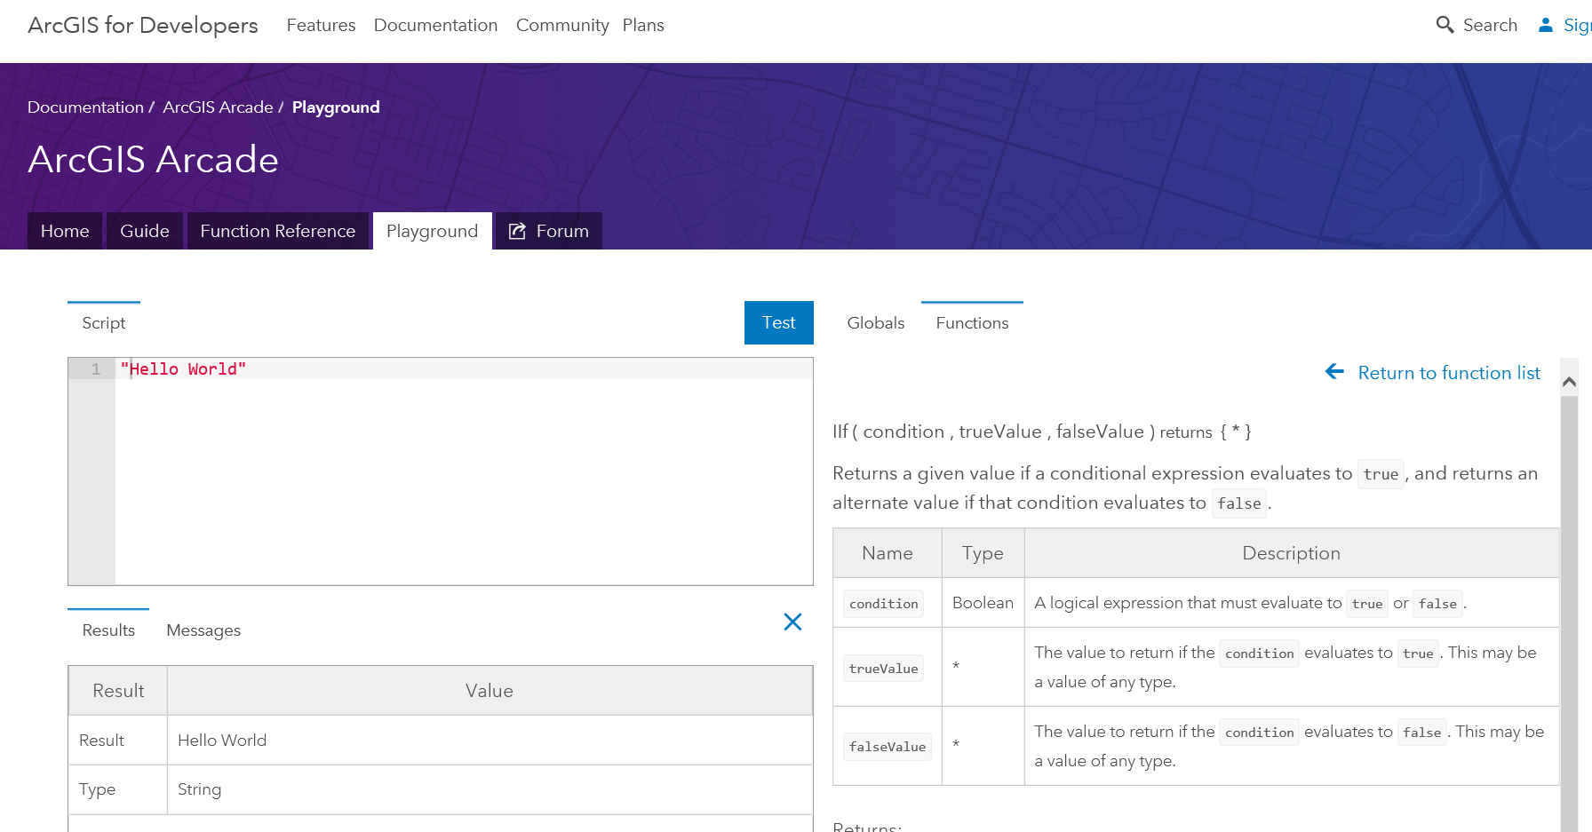
Exploring Profiles and Functions in the Playground
Notes:
[DAMIEN]
Demo Profiles in Playground
Look at the Language Help
[NEXT SLIDE]

Slide 22
Type System
Simple Types
Numbers
Booleans
Dates
Strings
Object Types
Dictionary
Feature
Array
Point
Line
Polygon
Multipoint
var myNumber = 10;
var myText = “Hello”;
var myDate = Date(2015,1,1);
var myBool = true;
var myDictionary = { “key1”: 10 };
var myFeature = { “geometry”: {…}, “attributes” {“key1”: 10 }};
var myArray = [1,2,3];
var myPoint = Point({….});
Dates, Dictionary, Feature, Point, Line… all have overloaded constructors.
Notes:
[DAMIEN]
Continuing with the Language.. Arcade does have a Type System
Simple types such as strings, Booleans, dates and object types, some of which are GIS Specific types, like Feature, Point, Line, Polygon, MultiPoint.
So you can see how we use them here. You declare a variable and assign parameters.
When using an object type, you use its name then use different overloaded calling parameters to create features and so forth.
[NEXT SLIDE]

Slide 23
Implicit and Explicit Type Casting
Implicit Casting
return 10 + “Hello”
Explicit Casting:
return text(10) + “Hello”
Implicit Casting
For Function Parameters
For Expressions
Explicit Casting
Functions cast between types
Number, Text, Date, Boolean
Notes:
[DAMIEN]
As there is a type system, there is Casting between types.
We had a lot of discussions on casting, and what was correct behaviour
Implicit casting is used for function parameters and expressions, numbers appended to string in this example. Explicit casting for functions cast between types, number, text, date, Boolean. To explain a bit more on explicit casting, this is when you want to explicitly state the number 10, as a text type.
[NEXT SLIDE]

Slide 24
If Statement
IF Statements are supported in the Language
For simple single line expressions, consider using Functions
IIF
Decode
When
if (myvalue==true) {
return 1;
}
else {
return 2;
}
Equivalent to:
IIF(myvalue==true, 1, 2)
Notes:
[DAMIEN]
As you would expect we have flow control statement and logic statement.
So we have IF… But you may also want to consider using the functions IIF, Decode, and When, which allow you to use functional equivalence, but using a shortened expression. Hence you can write a multi-line expression within a single line.
[NEXT SLIDE]

Slide 25
For Statement
For Statements
Same syntax as JavaScript
For In Statements
Iterates over indices of an array, or field names of a Dictionary or Feature
Break, Continue and Return Statements Supported inside Block
for (var z=1; z<100; z++ ) {
k+=z;
}
for(var k in myArray) {
n+=myArray[k];
}
Notes:
[DAMIEN]
We also have FOR loops.
It is similar in style to classic JavaScript or C. Additionally however we also have FOR IN which iterates over indices of an array, or field names of a dictionary/feature.
We also have break, return and continue as supported statements within the block
[NEXT SLIDE]

Slide 26
User Defined Functions
function MultiplyNumber(thenumber) {
return thenumber*10;
}
MultiplyNumber(10);
Function Keyword used to Declare Functions
Must be Declared ahead of Use
Variables defined inside of Function, have Local Scope
Functions cannot be declared inside of Functions.
Notes:
[DAMIEN]
We support user defined functions, however they have to be declared ahead of use. So if you are going to call a user defined function, you have to decfine it prior to calling.
The variables inside the function have local scope. Additionally you can’t declare functions within functions.
We have tried to keep the language as simple as possible, for example we haven’t gone for closure support that you typically get in JavaScript. We just want to keep it as simple and easy to learn as possible.
[NEXT SLIDE]

Slide 27
Variable Assignment
++myNumber
i=i+1;
myArray[10]=11;
myFeature.Field1 = “ddd”;
Variables can have their values reassigned.
Objects Types maybe Immutable, if passed into Arcade.
Arrays are not Sparse. They must be sequential.
Geometry Types are immutable inside. You cannot change the points in a path of a line.
Notes:
[DAMIEN]
We also have variables, that can assigned and reassigned. They can added, subtracted etc. and can even be assigned to different object types altogether.
However one thing to remember is that certain types are immutable. So for example the geometry type, $feature can be reassigned, however you can’t change the parameters of $feature. This is a key point, in that Arcade cannot edit immutable types that are passed in, so in the example of an immutable geometry type, it will remain the same regardless of your Arcade expression.
Additionally arrays must be sequential, and can’t handle gaps in the array.
I’m now going to pass over to Rene to give a few more demos to whet your appetite, and show what Arcade can really do!
[NEXT SLIDE]

Slide 28
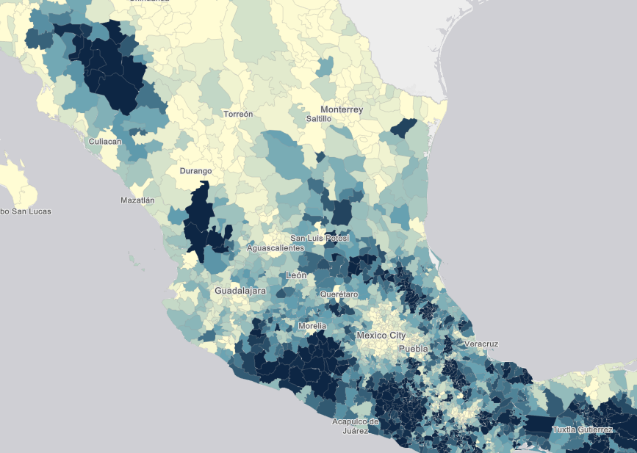
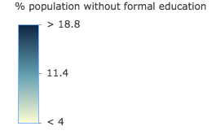
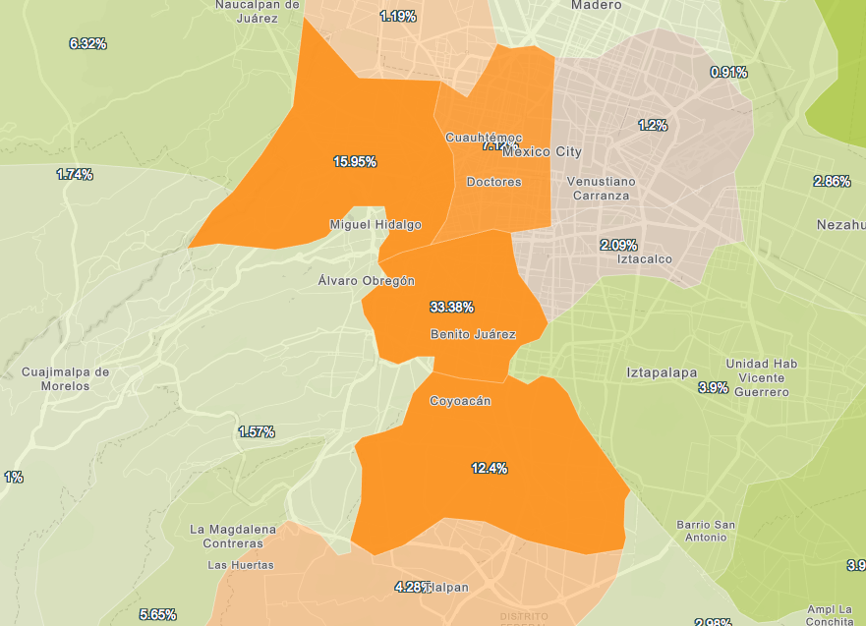
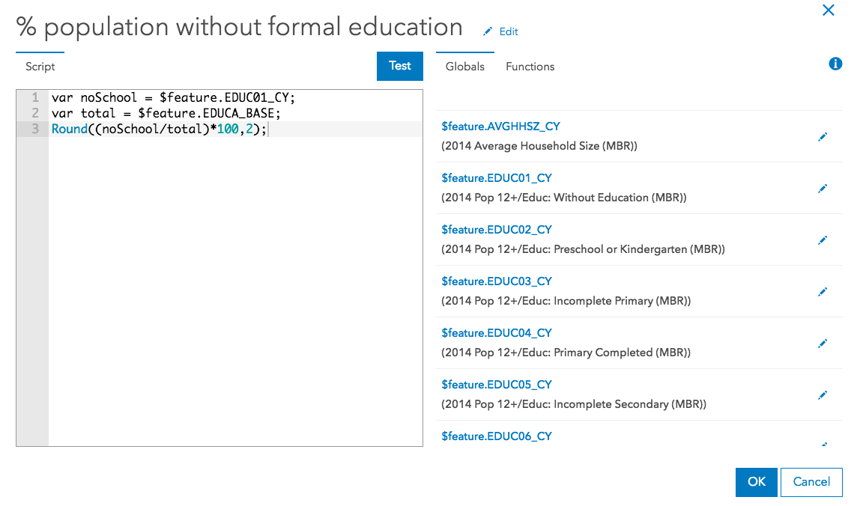
Demos
Notes:
[RENE]
Demo 3
Demo 4
[NEXT SLIDE]

Slide 29

Arcade and the ESRI JS API
ESRI JS API
Version 3.22
ESRI JS API
Version 4.5
Arcade
Arcade
Inside
Inside
“
Arcade Interpreter available in both 3.22 and 4.5 JavaScript API
Notes:
[RENE]
So the last part of the talk, is to look at using the Arcade Compiler inside the JavaScript API.
It is important to state the Arcade, works in Pro. It is available as a C++ engine, and a JavaScript engine
[NEXT SLIDE]

Slide 30
ESRI JS API : Arcade Expressions
Arcade Expressions set as Properties
Classes which have Arcade Expressions
ClassBreaksRenderer
UniqueValueRenderer
Visual Variables of Renderers
Color
Size
Opacity
Rotation
Supported for FeatureLayer and SceneLayer
Notes:
[RENE]
In the JS API, Arcade is exposed as properties of existing Classes.
Arcade expressions are set as string values on the properties on renderers and label classes.
So when talking about rendering or visualisation, you can set valueExpression for class break renderer or unique value renderer. Simple data renderers are not expressable, as they render everything with the same symbol.
You can vary visualisation with respect to color, size, opacity and rotation visual variables. This is supported for both FeatureLayer and SceneLayer.
[NEXT SLIDE]

Slide 31
ESRI JS API : Arcade Expressions
var renderer = new ClassBreaksRenderer({
valueExpression: "( $feature.TOT_VOTES / $feature.REG_VOTERS ) * 100",
valueExpressionTitle: "Title to Display"
classBreakInfos: [ ... ],
});
Expression Properties are set as Literal Strings
Arcade Interpreter will Execute valueExpression for every Feature
Notes:
[RENE]
Setting expressions is simply about setting the property as a String
So if you have a class break renderer, from 3.20 and 4.3 API’s you can set a valueExpression and valueExpressionTitle. The title will be used to describe the variable you are visualising through the valueExpression, which is set as a single line string in this sample.
[NEXT SLIDE]

Slide 32
ESRI JS API : Arcade Expressions in JS API 3.22
Arcade Expressions can be used For Labeling
var labelClass = new LabelClass({
labelExpressionInfo: {
expression: "$feature.STATION_NAME"
},
labelPlacement: "below-right",
minScale: 2500000
});
nameClass.symbol = new TextSymbol();
// set the label class to the feature layer
featureLayer.setLabelingInfo([ labelClass ]);
Notes:
[RENE]
3.22 supports Labelling Expressions through the labelExpressionInfo expression property.
This is the supported way to label now, as the former value property of that object has been deprecated as of 3.20. So you should be using Arcade in any version after 3.20.
[Does 4.5 support 2D labelling – if so, then need to add something on this]
[NEXT SLIDE]

Slide 33
Practicalities: Scripts in Script
<script type="text/plain" id="myScript">
Proper($feature.CityName)
</script>
...
var arcadescript = document.getElementById(“myScript").text;
Scripts within Scripts
Lots of String Escaping.
Embed Script in HTML using MIME type text/plain
Notes:
[RENE]
If you have a more complicated multi-line expression, what you can do is set it within a separate script element and call it via the getElementByID function. The benefit of this is that it is a clean way of calling your script, but as it is set in plain text the browser understands you aren’t trying to execute JavaScript.
[NEXT SLIDE]

Slide 34
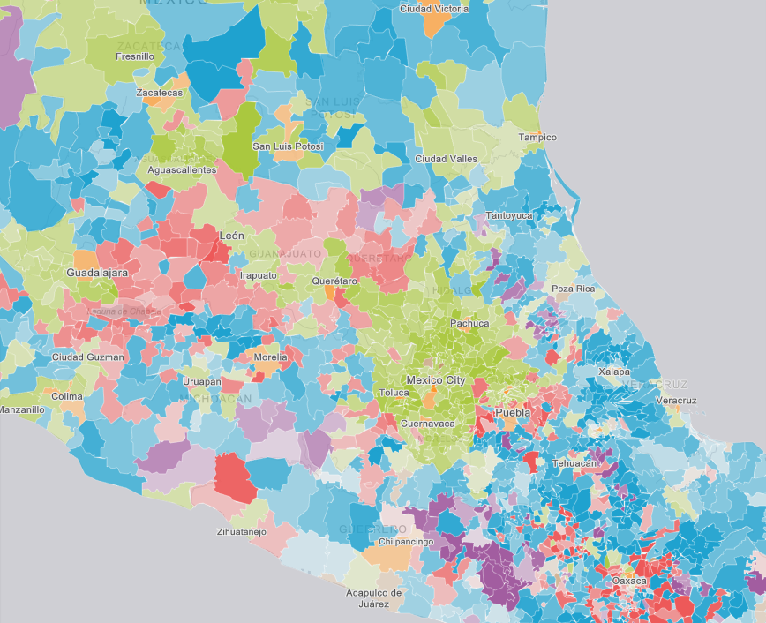
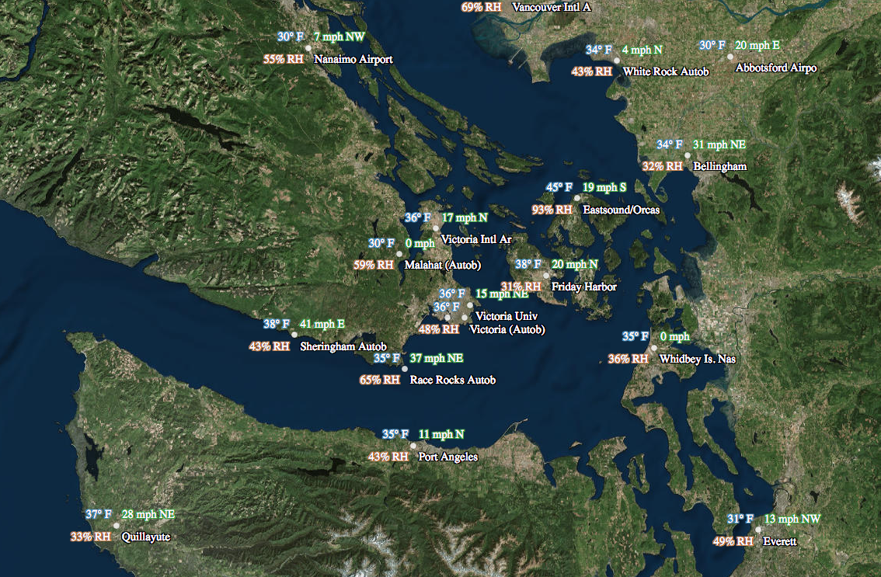
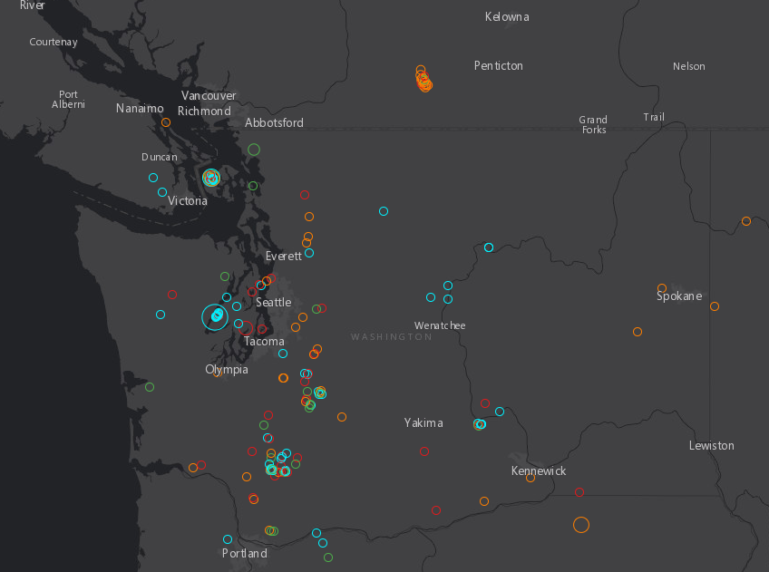
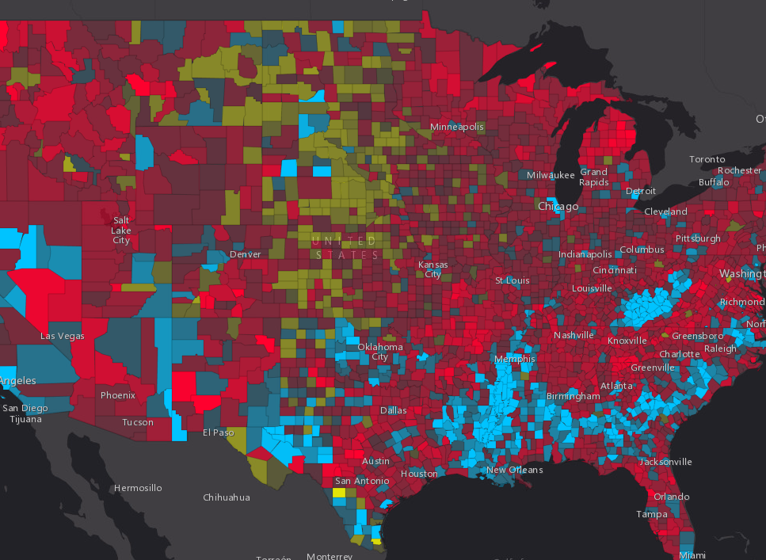
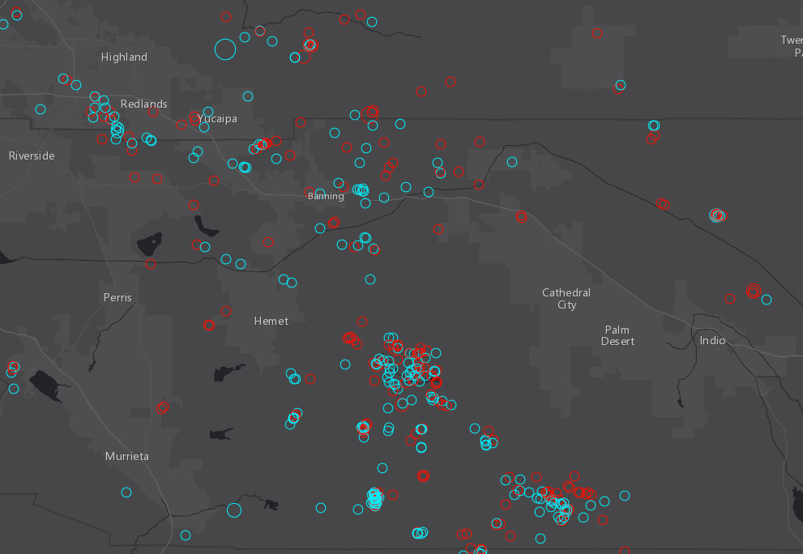
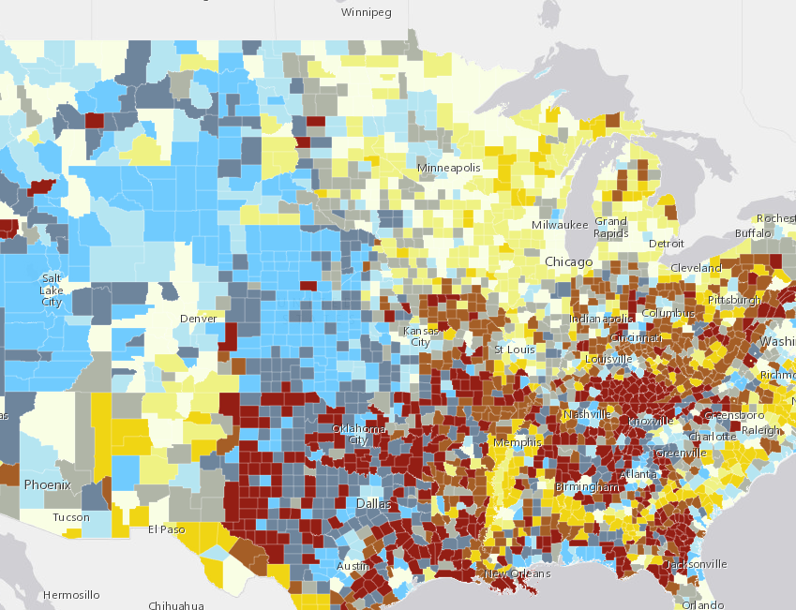
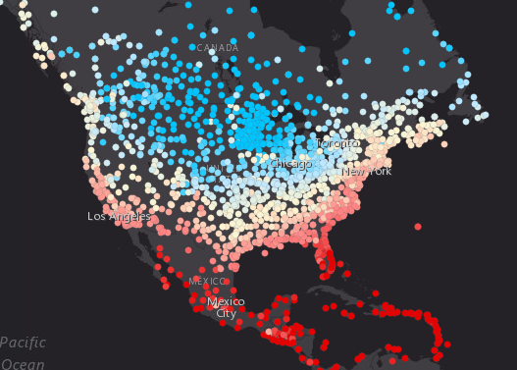
Demos
Programming in ESRI JS API with Arcade
Notes:
[RENE]
Demo 5
Demo 6
[NEXT SLIDE]

Slide 35
Arcade Interpreter : Inside of JS App using Arcade
Script Parsed into Syntax Tree
Compiled Arcade Script Executed
API Expression Property Set
Result Returned for On Demand Execution
Profile Context Constructed
On Demand Execution of Expression
Script Compiled
Standard Execution Lifecycle of Arcade Script
Script Parsed into Syntax Tree
Arcade Interpreter - Statement by Statement Execution
API Expression Property Set
Result Returned for On Demand Execution
Profile Context Constructed
On Demand Execution of Expression
Browser Restricted Execution of Arcade Script
Notes:
[RENE]
As a last note, I thought we could explain how Arcade is Executed…
There are actually two execution pipelines in the JS API, an optimised one, and interpreted one.
The reason why have two, is so that if the Browser has really been locked down in its behaviour, arcade expressions wil still work. The optimised pipelines is approximately 3x faster than the un-optimised pipeline.
The way the script is understood is as follows.
1. Expression is Parsed, and turned into a Machine Representation of the Script. A syntax tree
2. This machine representation is compiled into native JavaScript. This compilation process is a statement by statement re-expression of the script. It is not rewriting as JavaScript, but a language level articulation. This is because it must honour the Arcade type system, function behaviour everything.. The way of thinking about this, is to consider how C code is turned into assembly.
3. When the script is executed, the compiled function is called, with different input variables.
The browser restricted version, uses an Arcade Interpreter, where the statements are stepped through one by one, and does not compile the script to JavaScript.
With both pipelines, the driving factor has been security and speed. Arcade Expressions can only do what the language has allowed the user to express.
[NEXT SLIDE]

Slide 36
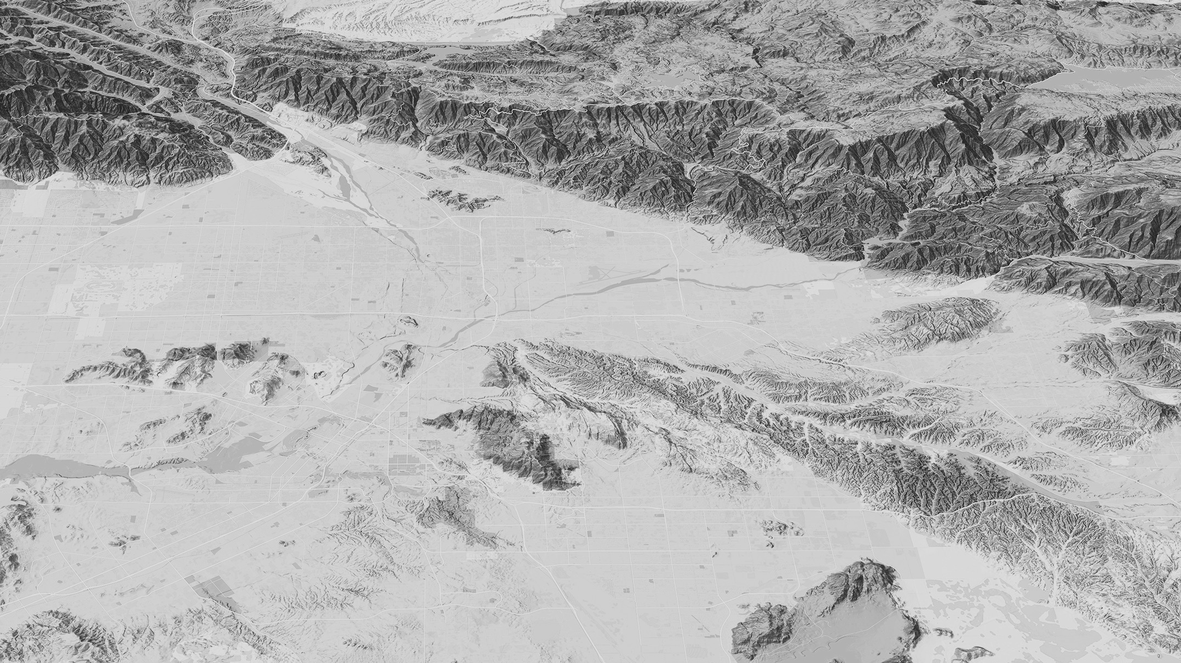

Finding Arcade Resources
Notes:
[RENE]
A big headache with any language or script expression.. Whether it is an Excel Formula, ActionScript, JavaScript or C# is where to find resources.
We have spent a bit of time putting together the help for Arcade online
[NEXT SLIDE]

Slide 37
Resources
For Arcade Documentation
https://developers.arcgis.com/arcade
Playground https://developers.arcgis.com/arcade/playground/
Using Arcade with JS API
https://developers.arcgis.com/javascript/latest/guide/arcade/index.html
Blogs and Posts https://blogs.esri.com/esri/arcgis/2016/12/19/introducing-arcade/
https://blogs.esri.com/esri/arcgis/2016/12/15/use-arcade-expressions-to-map-your-ideas/
http://odoe.net/blog/hello-arcade/
https://blogs.esri.com/esri/arcgis/2017/01/10/using-arcade-expressions-in-web-apps/
https://blogs.esri.com/esri/arcgis/2017/05/15/use-arcade-expressions-to-map-the-improvement-ratios-in-your-area/
https://blogs.esri.com/esri/arcgis/2017/05/23/creating-a-predominance-visualization-with-arcade/
https://blogs.esri.com/esri/arcgis/2017/06/28/whats-new-in-arcade-june-2017/
https://blogs.esri.com/esri/arcgis/2017/08/24/3d-geoplanner-and-arcade/
Notes:
[RENE]
Arcade documentation homepage
Playground
Javascript API and Arcade
Blogs and Posts
[NEXT SLIDE]

Slide 38
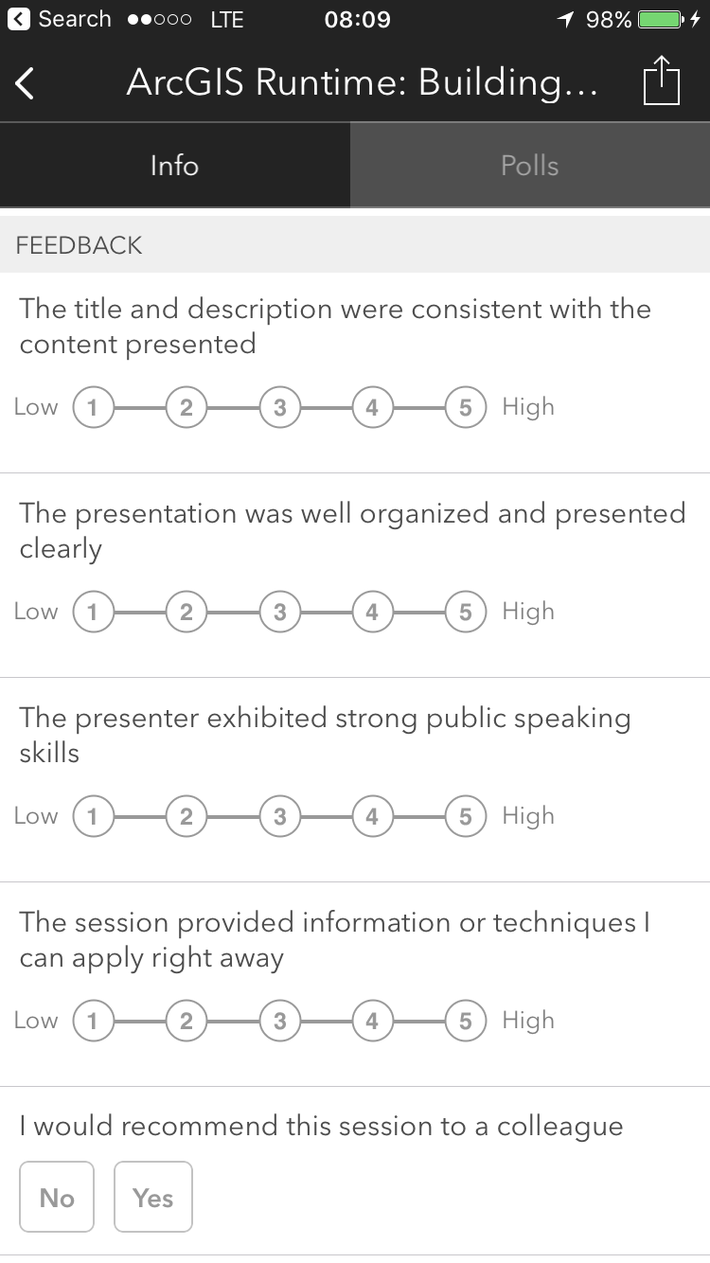

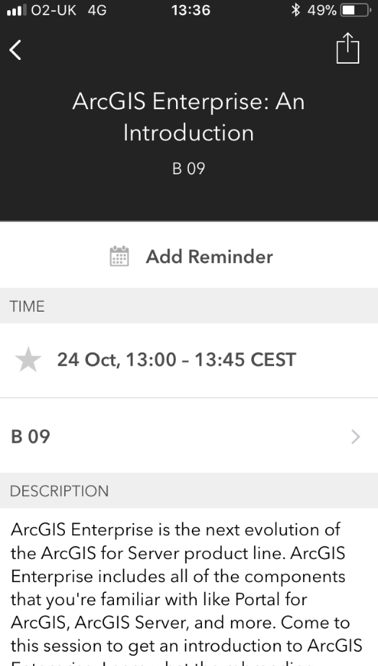
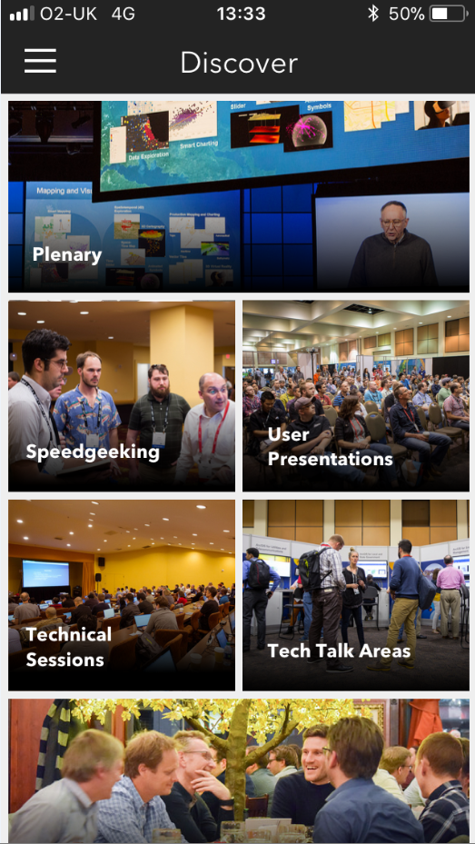
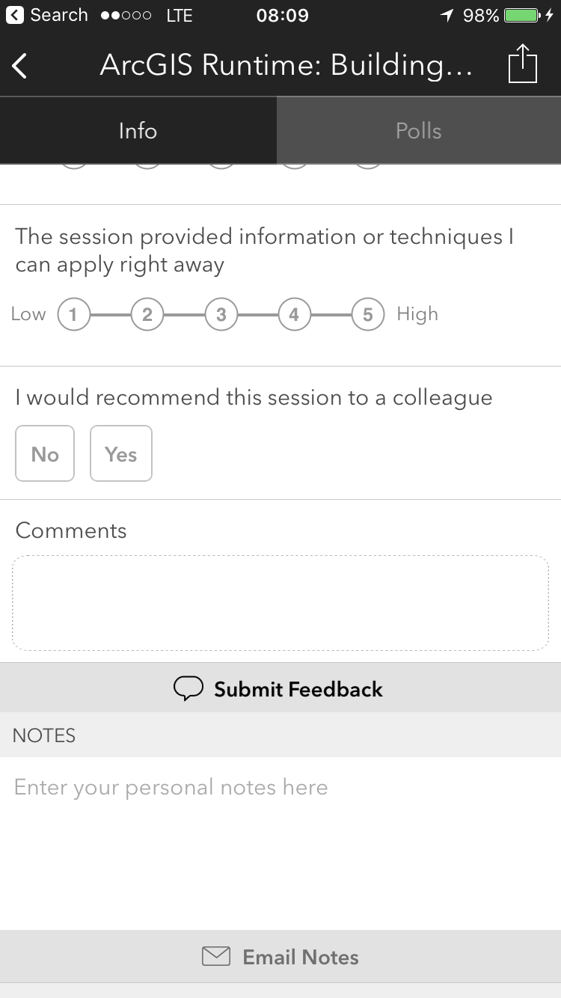
Please Take Our Survey!
Scroll down to the
“Feedback” section
Download the Esri Events app
and go to Esri Developer Summit
Europe
Select the technical session you attended
Complete Answers,
add a Comment,
and Select “Submit”
Notes:
[RENE]
Please take our survey to provide feedback on this session
[NEXT SLIDE]

Slide 39
Notes:
[FIN]

